Slide 1


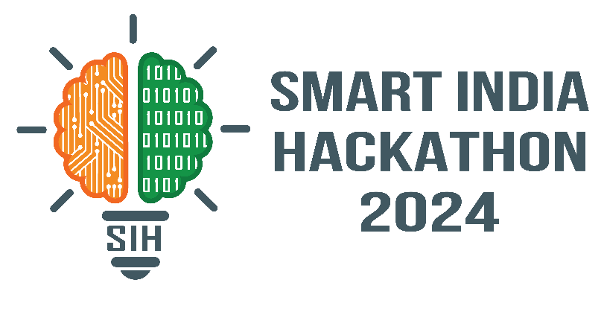

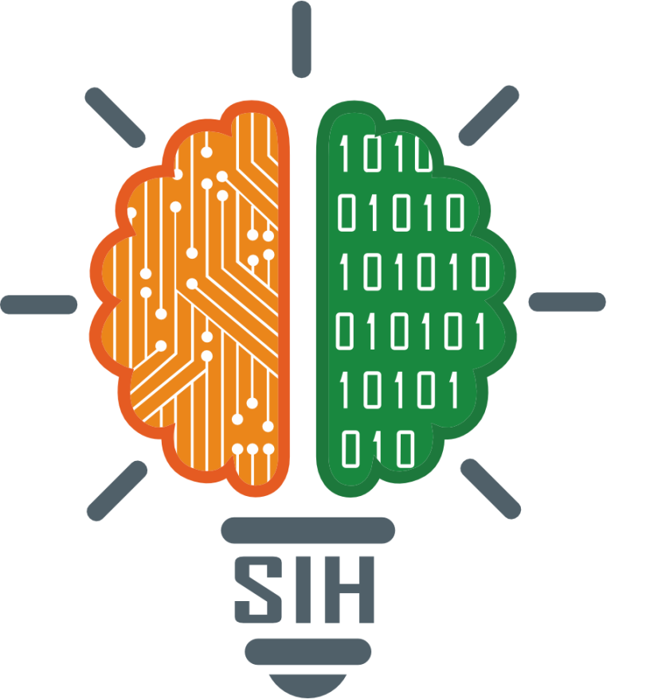
VITISH 2024 (SIH Internal Hackathon)
Problem Statement ID – 1624
Problem Statement Title – To develop an Artificial Intelligence (AI) based model for electricity demand projection including peak demand projection for Delhi Power System.
Theme – Smart Automation
PS Category – Software
Team ID – VIT097
Team Name – Aata Vaajle ki Baara

Slide 2
SparkTech
Proposed Solution
Integrated Portal : Merges weather and power consumption data.
ML Predictions : Forecasts future power demand using machine learning.
Real-Time Insights : Displays current and predictive power and weather graphs.
District-Level Data : Provides detailed user friendly data for all 11 Delhi districts.
Analyze Feature : Explores trends between power consumption and weather.
User-Friendly UI : Simplistic design with essential features.

Slide 3



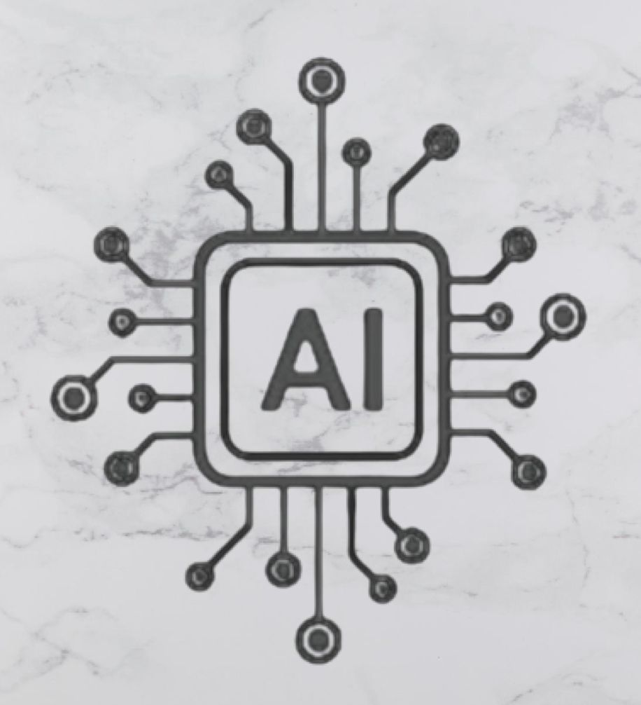
TECHNICAL APPROACH
Framework : ReactJS is utilized for creating a dynamic and responsive user interface, while Figma is employed for designing and prototyping the user experience, ensuring a user-friendly and visually appealing interface.
Data Collection : Gather historical weather and power consumption data for Delhi, including temperature, humidity, windspeed and precipitation
Backend : Implemented Flask to handle server side logic and API requests, integrating ML models with the frontend to provide real-time insights
Model Development : Train ML models using Python to analyse data and forecast future power demand based on weather conditions
Frontend : Developed the user interface with ReactJS for a dynamic and responsive experience, and use Figma for designing and prototyping the user interface
Database : Firebase provides a scalable cloud database and authentication services, allowing for real-time data management and secure user access. Firebase Authentication ensures user data is protected with robust security measures while simplifying the sign-in process.
APIs : Flask acts as a lightweight backend framework, handling server-side logic and serving as an API. It processes data, manages communication between the frontend and the database, and provides endpoints for interacting with machine learning models.
ML : Machine learning models, developed using Python, analyze historical weather and power consumption data to forecast future demand. These models leverage advanced algorithms to provide accurate predictions and insights, helping optimize power management strategies.

Slide 4
FEASIBILITY AND VIABILITY
The project is highly feasible as it employs a blend of reliable and well-established technologies.
The frontend delivers an engaging and responsive user experience, while the backend manages data processing and server interactions efficiently.
The integration of machine learning models allows for accurate predictions and suggestions based on historical data.
This combination ensures that the system can effectively handle large volumes of data, provide real-time insights, and scale as needed, making the solution both practical and robust for long-term use.
Future Prospects
The project has the potential for further development by incorporating additional data sources and advanced machine learning techniques to enhance prediction accuracy.
Future enhancements could include expanding the system's capabilities to support other regions or integrating real-time energy management features for even greater impact.

Slide 5
IMPACT AND BENEFITS
Potential Impact on the Target Audience
Enhanced Power Management : Provides the Delhi government with better tools for forecasting and managing power demand.
Benefits of the Solution
Social : Improves reliability of power supply, leading to fewer outages and better quality of life for residents.
Informed Decision-Making : Offers insights and predictions that aid in optimizing power purchase and distribution.
Economic : Reduces costs associated with power procurement and enhances operational efficiency.

Slide 6
RESEARCH AND REFERENCES
https://www.wunderground.com/history/monthly/in/new-delhi/VIDD/date/2022-7
https://npp.gov.in/dgrReports
https://cea.nic.in/dashboard/
https://www.kaggle.com/datasets/mahirkukreja/delhi-weather-data
https://www.worldweatheronline.com/new-delhi-weather-history/delhi/in.aspx
https://www.ceicdata.com/en/india/electricity-consumption-utilities/electricity-consumption-utilities-delhi#:~:text=Electricity%20Consumption%3A%20Utilities%3A%20Delhi%20data,to%202022%2C%20with%2027%20observations

